Slide 1
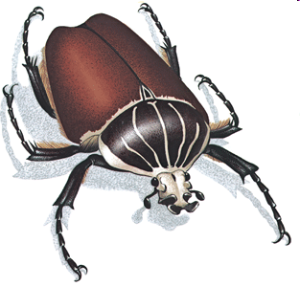

Slide 3
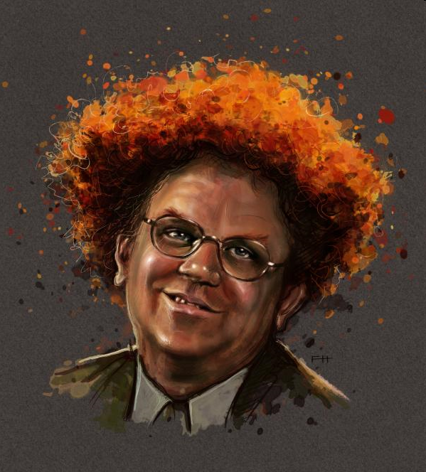

Slide 4
Sketch one only…

Slide 7
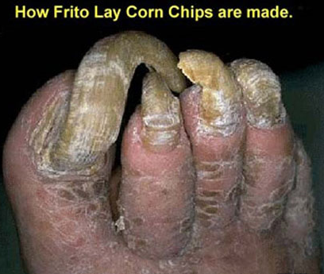
Sketch loose and fast…

Slide 8
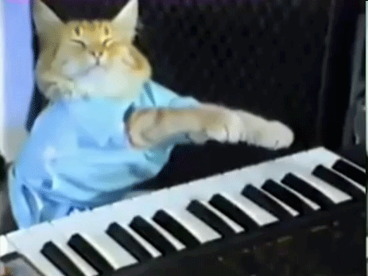
Add values (lights and darks)…

Slide 9
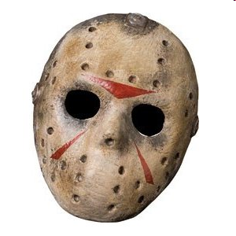
Add values (lights and darks)…

Slide 10
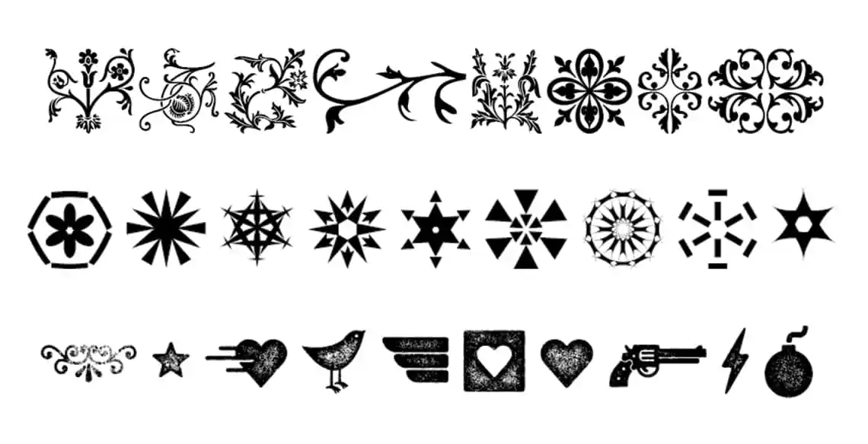
Sketch one or two…

Slide 11
Add values (lights and darks)…

Slide 13
Sketch one or two you dig…

Slide 17
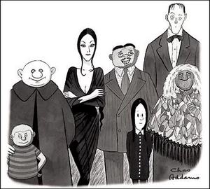
Sketch one only…

