Slide 1
Psychedelic Art
Andrew & Chris

Slide 2
What is a simple way to describe psychedelic art?
Swirling patterns, erotic images, and hidden messages precived in colorful and confusing artwork. The art looks like things you might see while on psychedelic drugs such as mushrooms, acid, or DXM.

Slide 3
Where Did It Originate From?
Certain artists such as Rick Griffin, Wes Wilson, and Victor Moscoso were the main pioneers of the art style, but it really originated from experimentation with psychoactive drugs. The effects of the drugs led to massive explosions of colors and repeated limbs being shown. This led to psychedelic art being what it is today.

Slide 4
Key Psychedelic Artists
Rick Griffin- After seeing psychedelic rock posters designed by Stanley Mouse and Alton Kelly in San Francisco, Griffin participated in Ken Kesey’s acid tests that inspired him to make the art he does now. (Most famous for Flying Eyeball)
Wes Wilson- During the Haight-Ashbury movement, the demand of psychedelic posters and other works in the San Fran area. Wilson started to take commissions and published his first poster being a Vietnam war protest poster and continued to make commissions, including for Chet Helms Family Dog productions.
Victor Moscoso- Inspired by one of his teachers at Yale, Moscoso’s fame came from his posters at dance halls and clubs. Moscoso worked for Zap Comics which let him work with characters such as Mickey Mouse, Donald Duck, and Bugs Bunny.

Slide 5
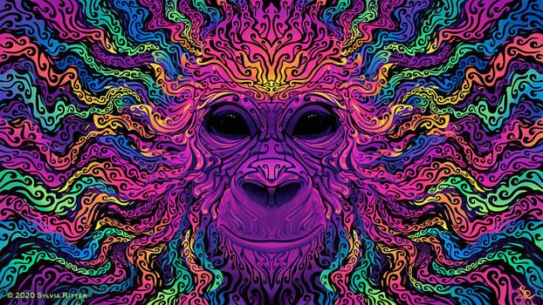
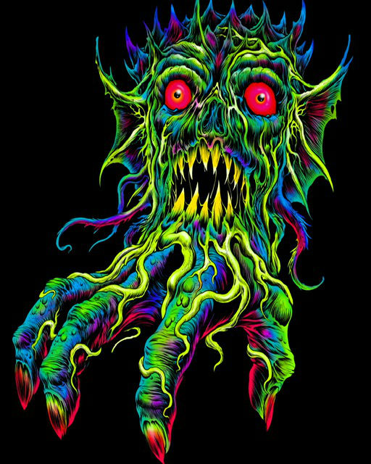
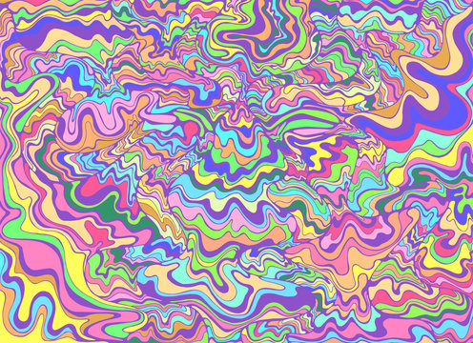
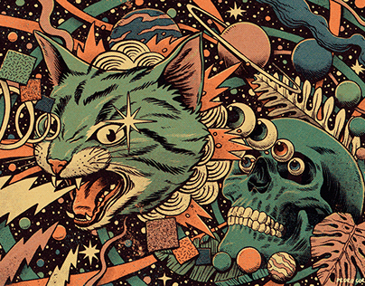
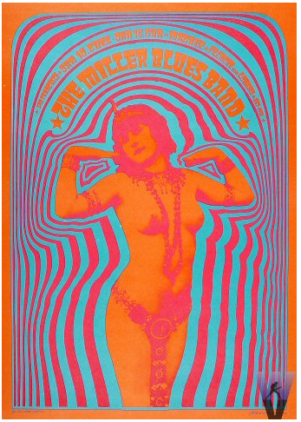
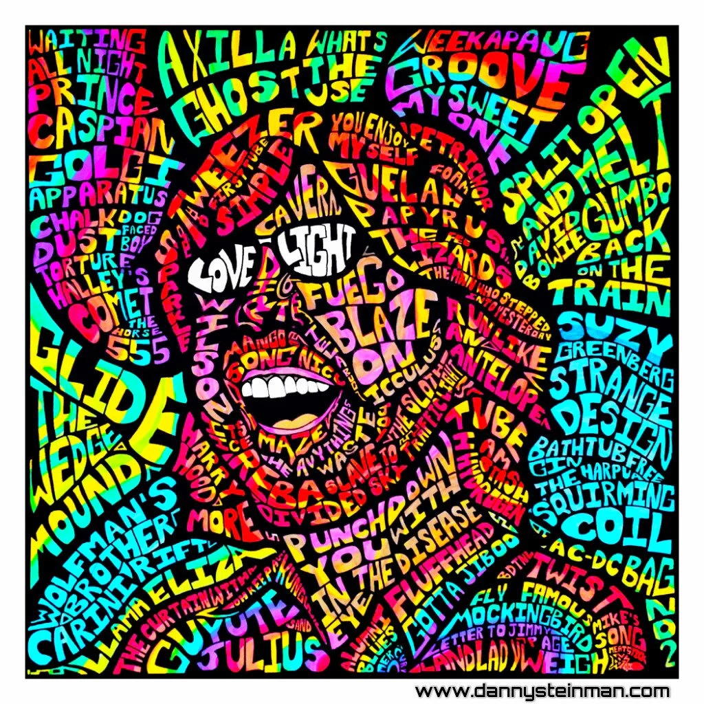
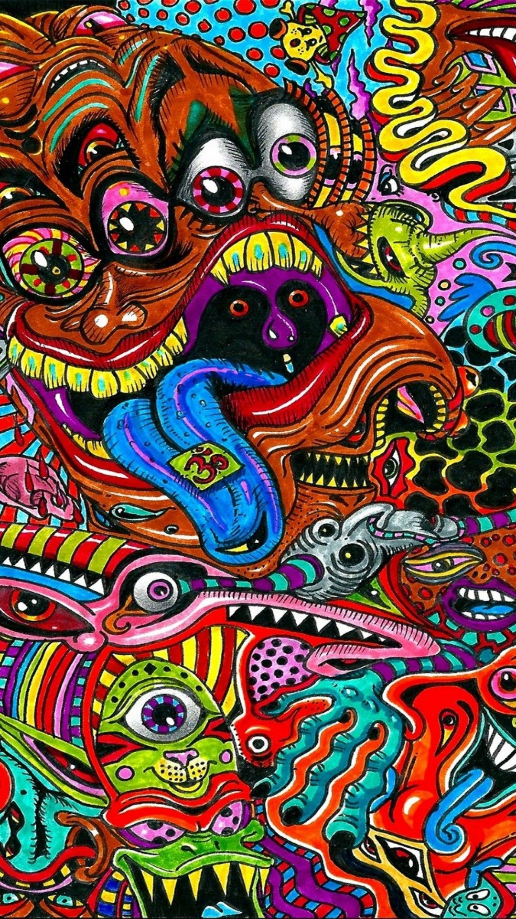
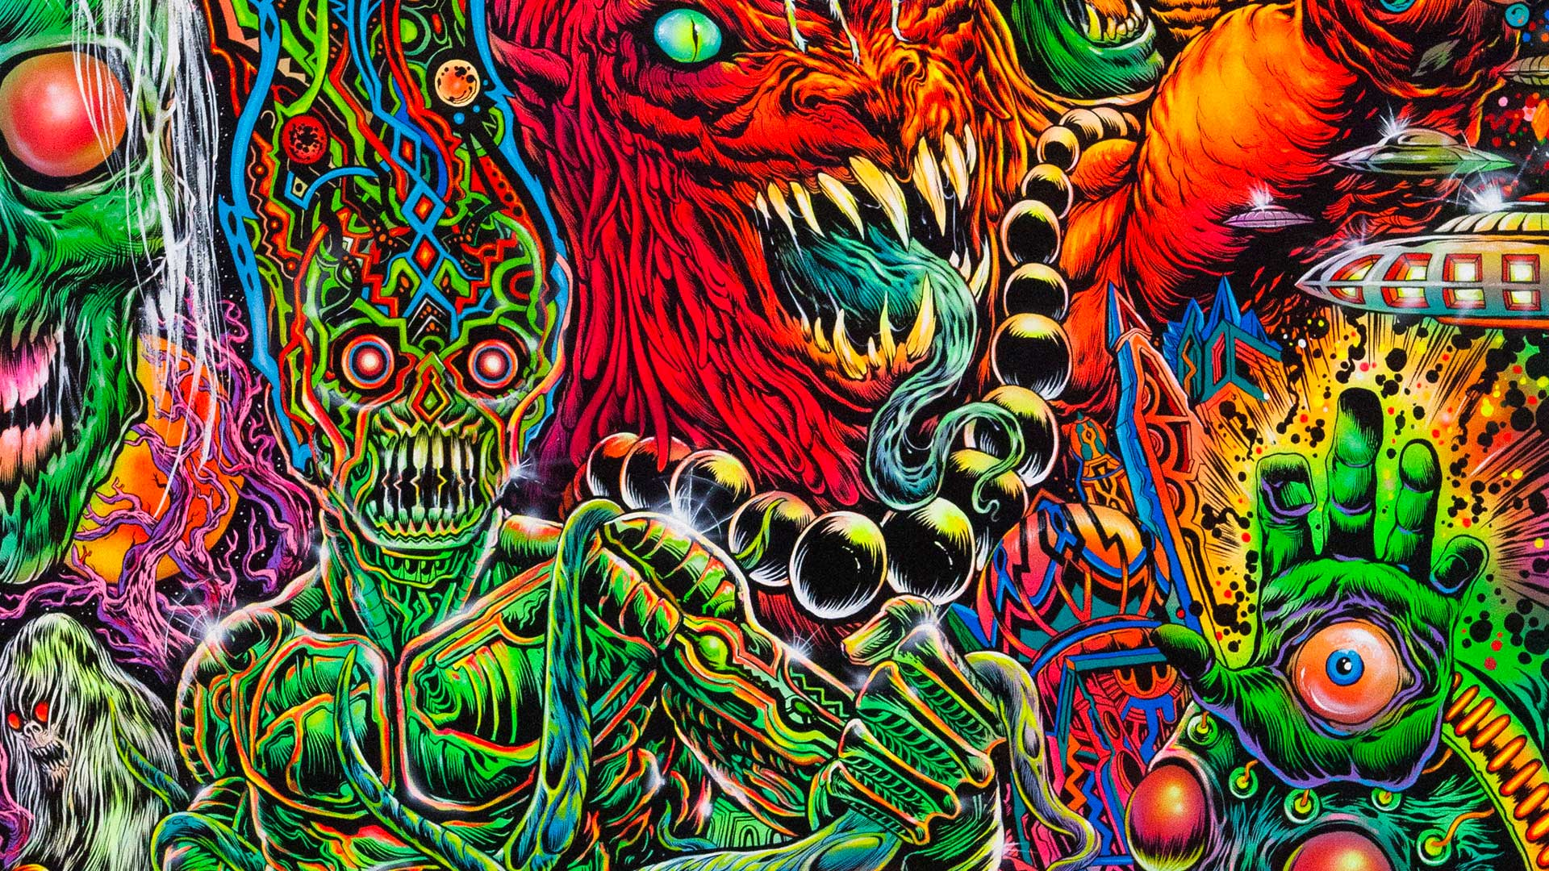
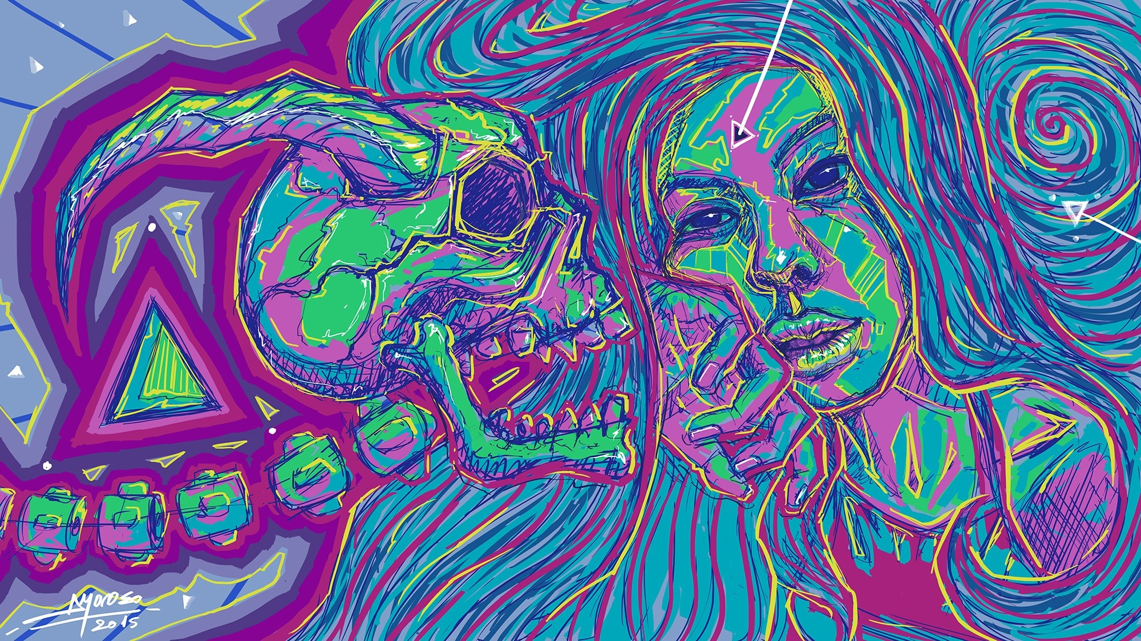
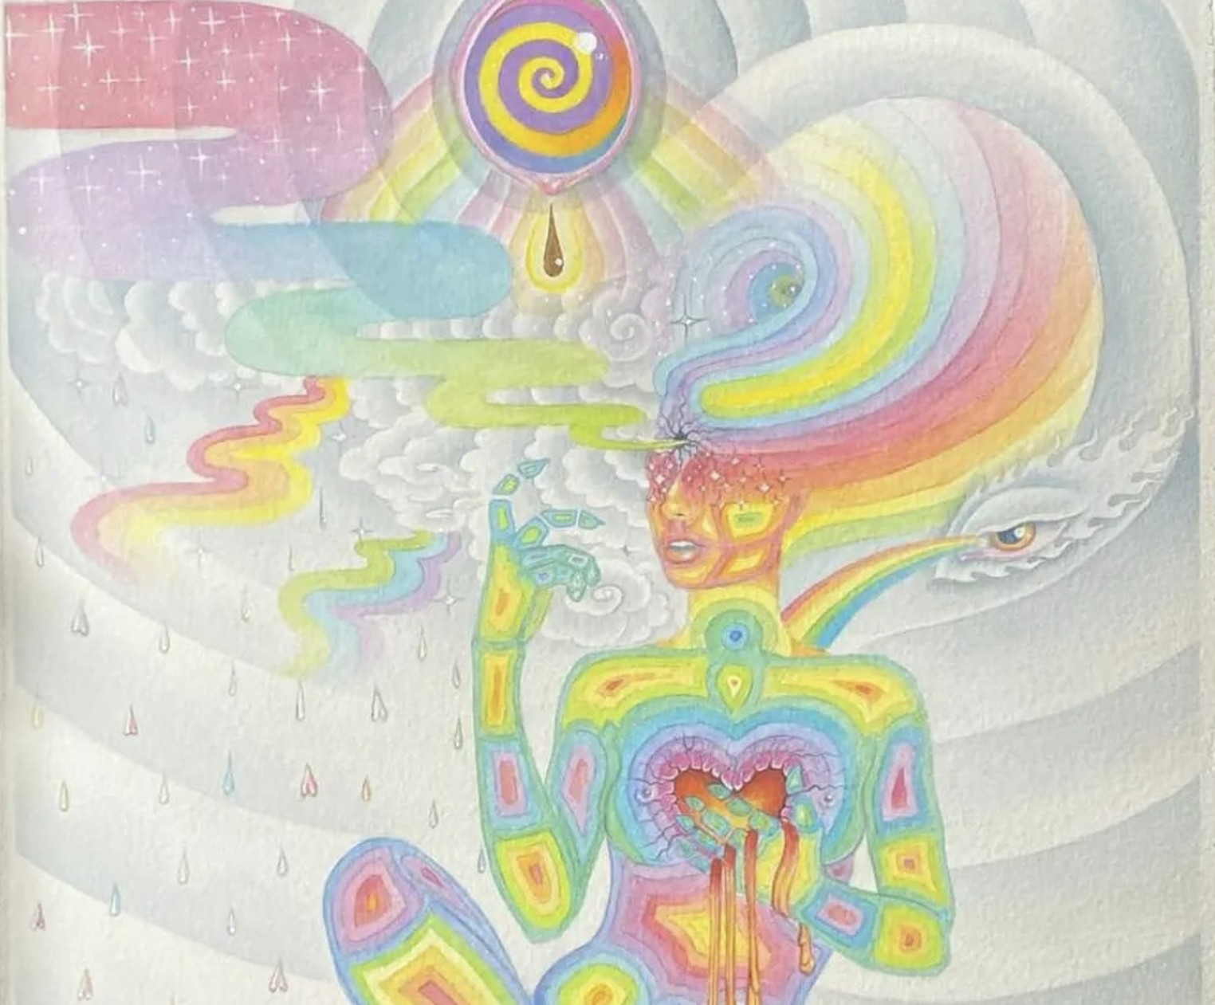

Slide 6
How Has Psychedelic Art Impacted The World Today?
The 1960s Psychedelic Art movement made a strong impact on comic book artists at the time, who went on to create an alternative and revolutionary type of comic book art that became known as “Underground Comix.” The creation of comic art also led to the emergence of concert posters and record album covers for bands and artists such as The Who and Jimi Hendrix, with Psychedelic Art being seen as a major influence in the development of these artistic expressions. Now psychedelic art is seen in movies, band posters, and even marketing!

Slide 7
What did we learn about psychedelic art?
We learned that psychedelic art was very popular throughout time and is interpreted in many different ways by multiple different artists. Psychedelic art is complex but also simple shapes with a mixture of colors to create crazy designs. It's used a lot in band posters, hippie culture, and less commonly is sometimes used in just general design

Slide 8
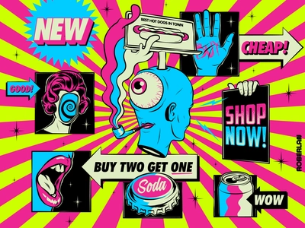
Video links
Where the 1960s "psychedelic" look came from - YouTube
Who invented PSYCHEDELIC art? - YouTube

